Slide 1
Introduction

Slide 2
Real Time System – A Definition.
Technology Advancements.
Embedded System Applications- Example
What is Real Time?
Real-Time Categories.

Slide 3
Real Time System – A Definition
A real-time system (defined by IEEE) is a system whose correctness includes its response time as well as its functional correctness.
In other words, in a real-time system, it not only matters that the answers are correct, but it matters when the answers are produced.
A Late Answer is a Wrong Answer!

Slide 4
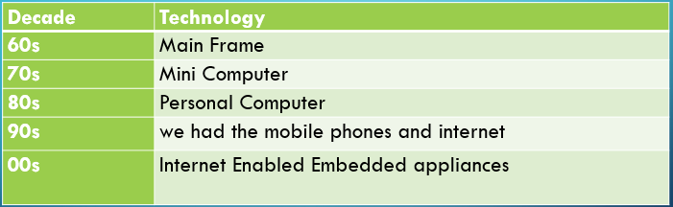
Technology Advancements

Slide 5
So, as we just saw that the embedded systems are being increasingly used in new applications and all this have real time in nature in the sense that based on some events the action must take place within certain time
So, as we just saw that the embedded systems are being increasingly used in new applications and all this have real time in nature in the sense that based on some events the action must take place within certain time

Slide 6
Why surge in embedded applications?
Trend of reducing cost of computers:
Processors
Memory
Flexibility due to Internet
Reducing Power Consumption
Reducing Size
Increased:
Processing Power
H/w & S/w reliability

Slide 7
What is the basic difference between a PC or a mini computer or a work station versus a real time system.?
A real time system is a time bound system which has well defined fixed time constraints. Processing must be done within the defined constraints or the system will fail.

Slide 8
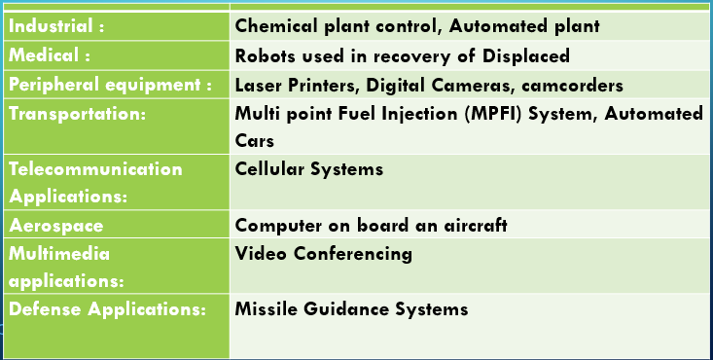
Embedded System Applications- Example

Slide 9
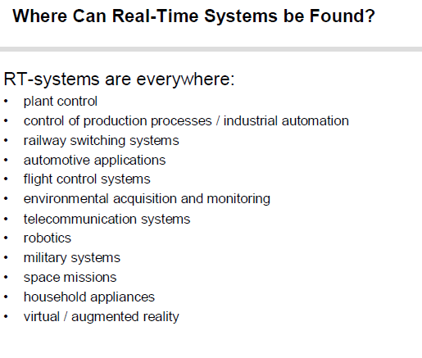

Slide 10
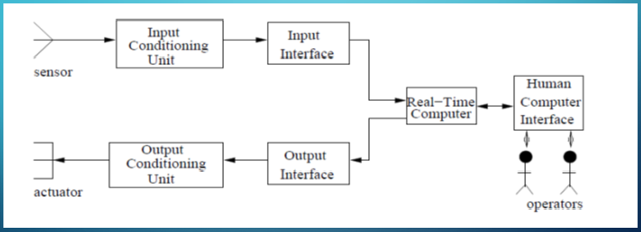
Model of Real Time System

Slide 11
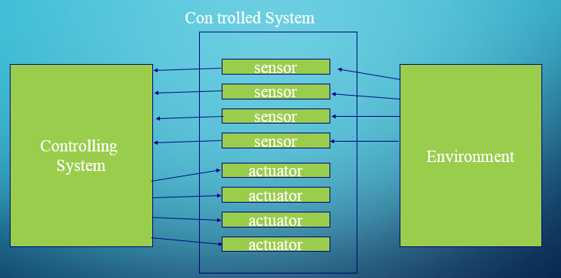

Slide 12
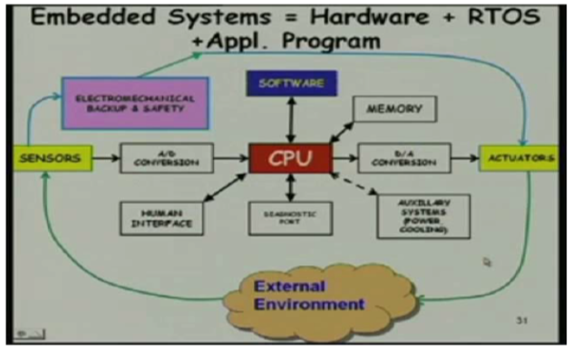

Slide 13
A real-time system is any information processing system which has to respond to externally generated input stimuli within a finite and specified period
The correctness depends not only on the logical result but also the time it was delivered
Failure to respond is as bad as the wrong response!

Slide 14
Benefits of using RTS
1.Maximum Consumption :- RTOS give maximum consumption of the system and gives us more output while using all the resources and keeping all devices active. 2. Real time operating system in embedded system: – Due to small size of programs RTOS can also be used in embedded systems like in transport and others. 3. Task Shifting: – There is very little time assigned to shifting tasks in these systems. 4. Focus on Application: – It focuses on the current application which is running, rather then other applications which are in waiting state of life cycle.

Slide 15
5. Error Free: – RTOS is error free that mean it has no chances of error in performing tasks. 6. Memory Allocation: – Memory allocation is best managed in these type of systems. 7. 24-7 systems: – RTOS can be best used for any applications which run 24 hours and 7 days because it do less task shifting and give maximum output.

Slide 16
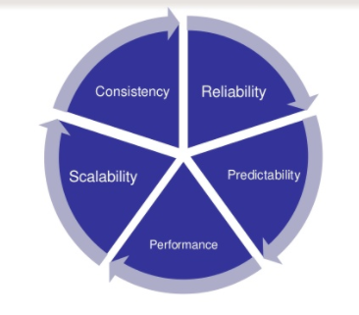
Characteristics of RTS

Slide 17
Types
Hard Real Time: Task is one that constrained to produce its result within certain predefined time bound. If deadline missed, system is considered as failed.
Firm Real Time: Task is one that required to produce its result within certain predefined time bound. If deadline missed, system is not considered as failed. Late result simply discarded.
Soft Real Time: Task also have time bounds associated with them. Time constraint is expressed as average value.

